Slide 1
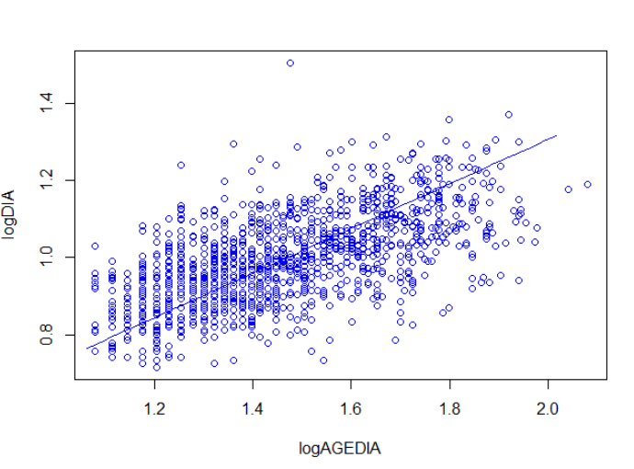
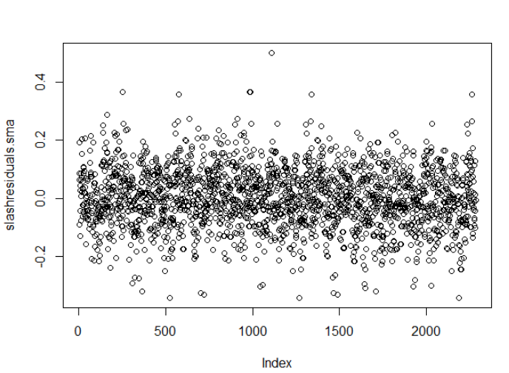
SMA plot and residuals:
Coefficients:
elevation slope
estimate 0.1493704 0.5784213
lower limit 0.1215234 0.5599808
upper limit 0.1772174 0.5974689
H0 : variables uncorrelated
R-squared : 0.3765698
P-value : < 2.22e-16

Slide 2
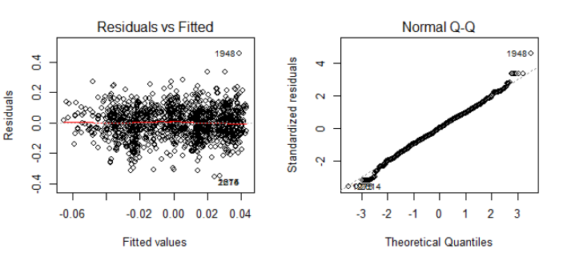
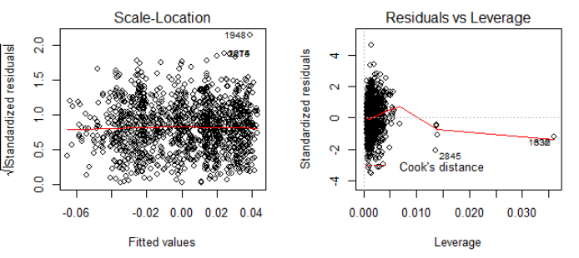
OLS using SMA residuals:
Growth rate:
10(-1.43+ 0.1823temp - 0.0045temp2 - 0.3018aridity) * 0.5784age^{-0.4216}

Slide 3
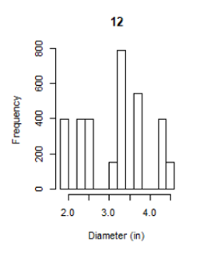
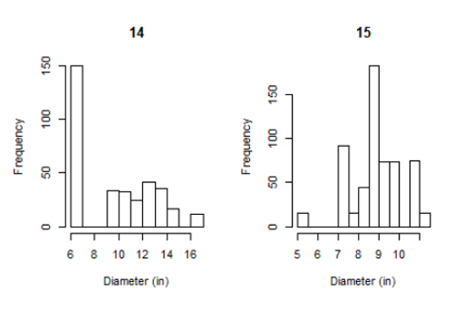
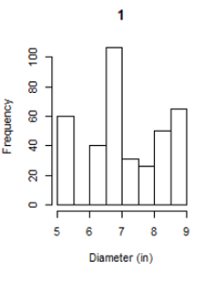
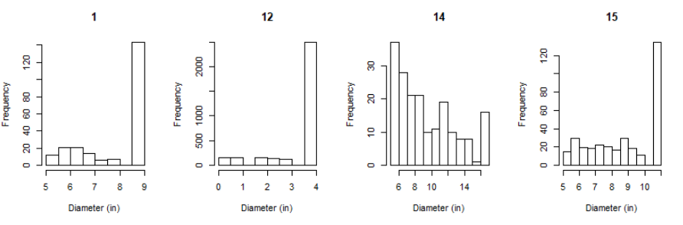

Slide 4
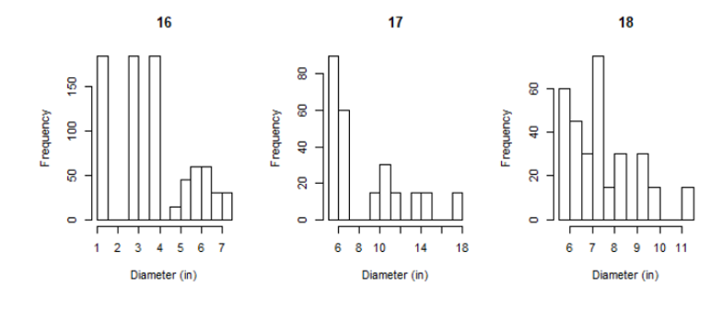
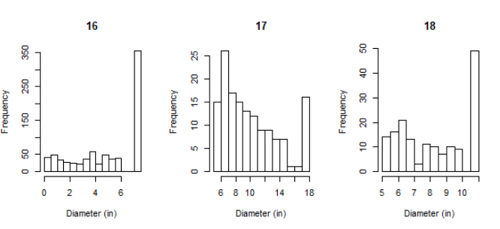

Slide 5
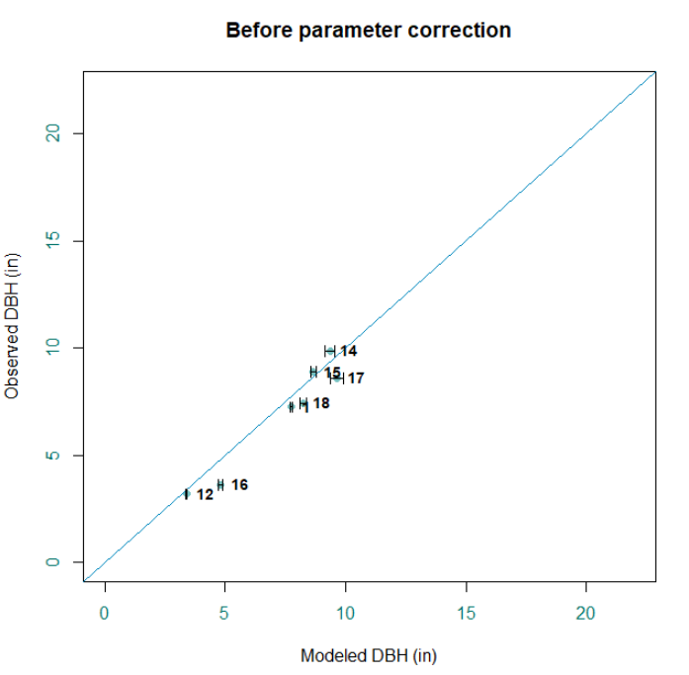
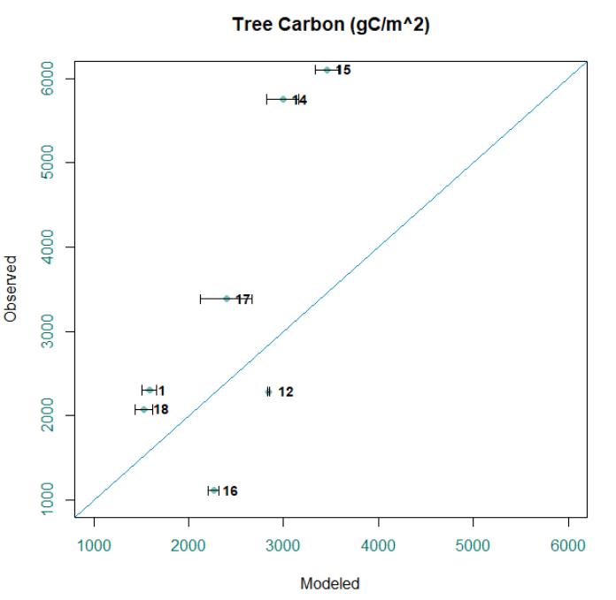

Slide 6
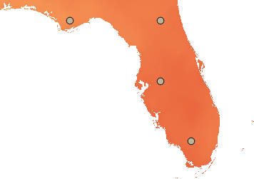
Grams of Carbon stored in living biomass in year 2100
Site | Mean gC/m² | SD
Panhandle | 4379.82 | 222.90
North | 5832.73 | 300.50
Central | 6312.21 | 435.53
South | 4904.68 | 330.86

Slide 7
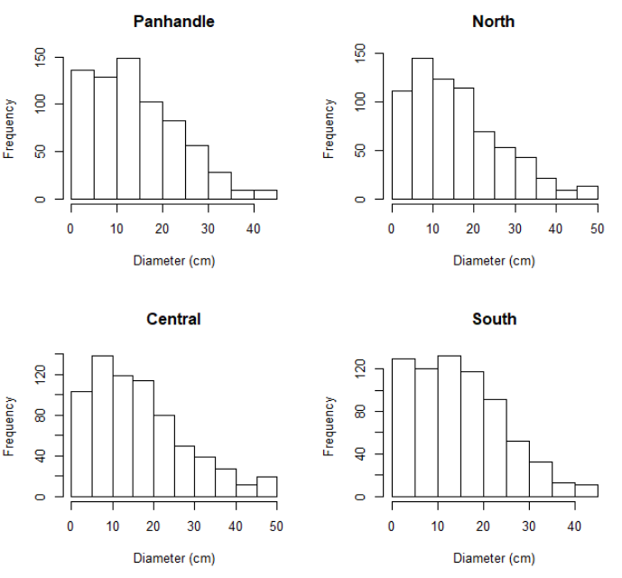

Slide 8
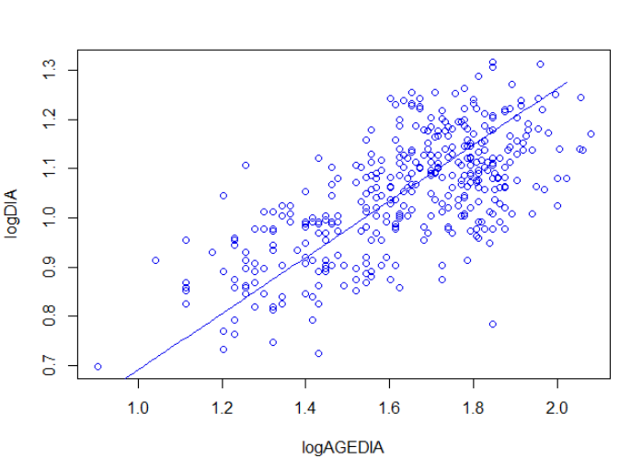
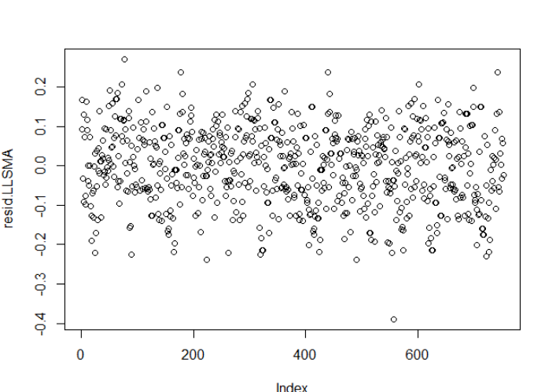
SMA plot and residuals:
Coefficients:
elevation slope
estimate 0.11929406 0.5718692
lower limit 0.06797308 0.5415208
upper limit 0.17061505 0.6039184
H0 : variables uncorrelated
R-squared : 0.4207783
P-value : < 2.22e-16

Slide 9
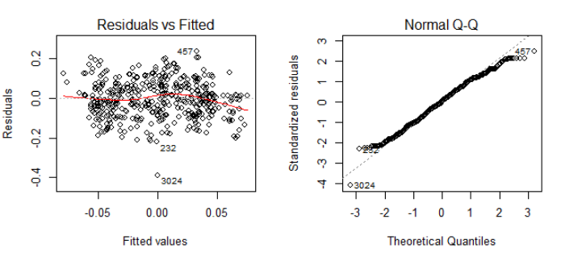
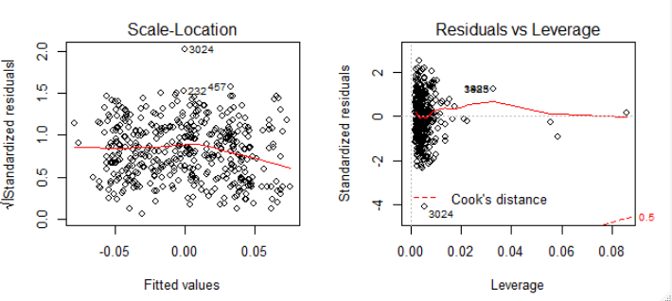
OLS using SMA residuals:
Growth rate:
10(0.9333 - 0.009259CN + 0.011340CN*aridity - 0.9775aridity) * 0.5719age^{-0.4281}

Slide 10
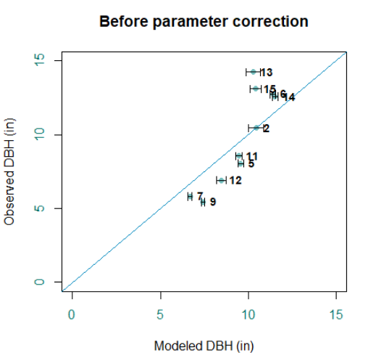
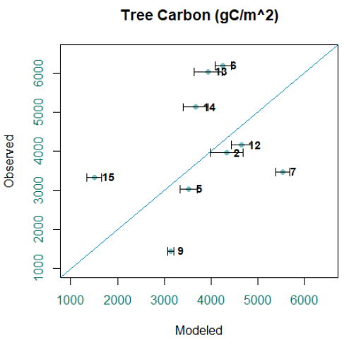

Slide 11
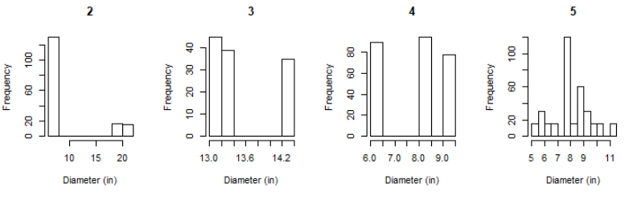
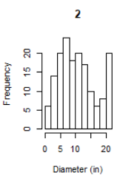
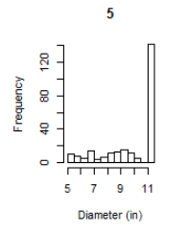

Slide 12
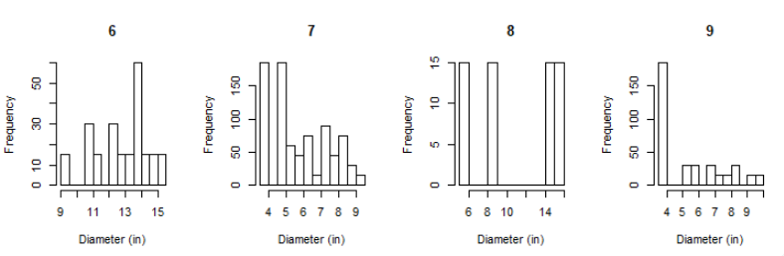
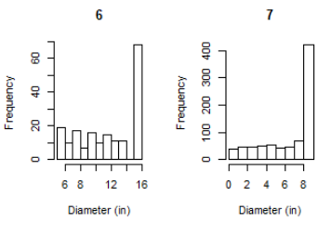
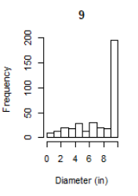

Slide 13
